Slide 1
Chitrakut Environs
Steps Towards Sustainability

Slide 2
GreenBandhu
Is in the business for the last eight years. Has 300 projects of various capacities running in the country. Our systems can handle waste of 10 kg to 1000 kg or more capacities.
FLC Bangalured is an effort to give back to the city in terms of community involvement and participation.

Slide 3
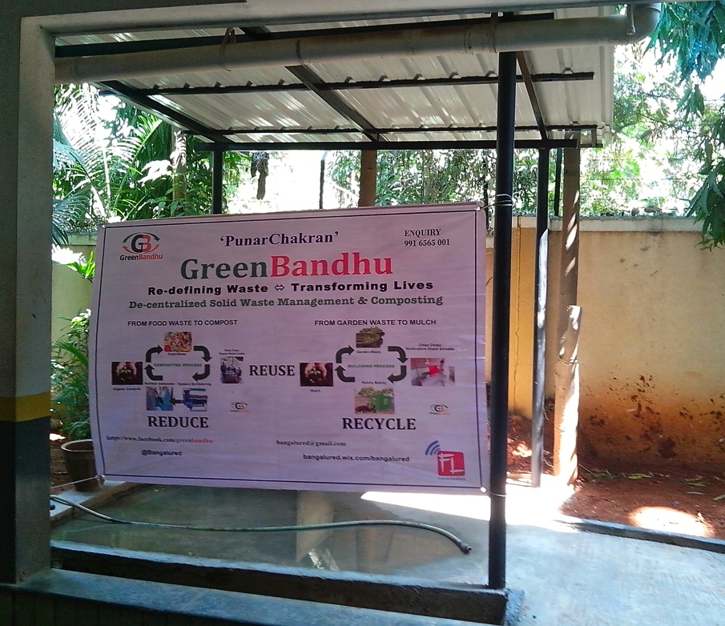
Chitrakut Environs
Steps Towards Sustainability
After successful deliberations, the infrastructure was put in place by the community in consultation with GreenBandhu. With firm order in place the production of equipment commenced in Gurgaon, Haryana, HQ, GreenBandhu

Slide 4
The Beginning
GreenBandhu’s equipment requires cover to prevent water getting into the machinery, can be installed on terraces as well. A 3- phase power supply. Water supply and drainage facility.

Slide 5
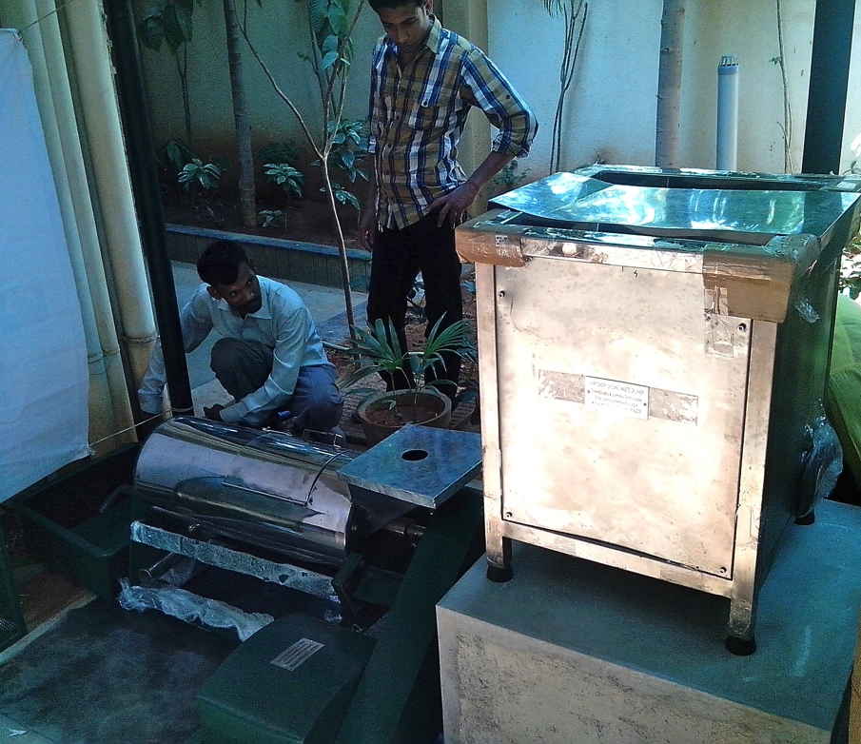
Organic Waste Processing Unit
GreenBandhu personnel helping set up the Organic waste processing unit at Chitrakut Environs, Bangalore.

Slide 6
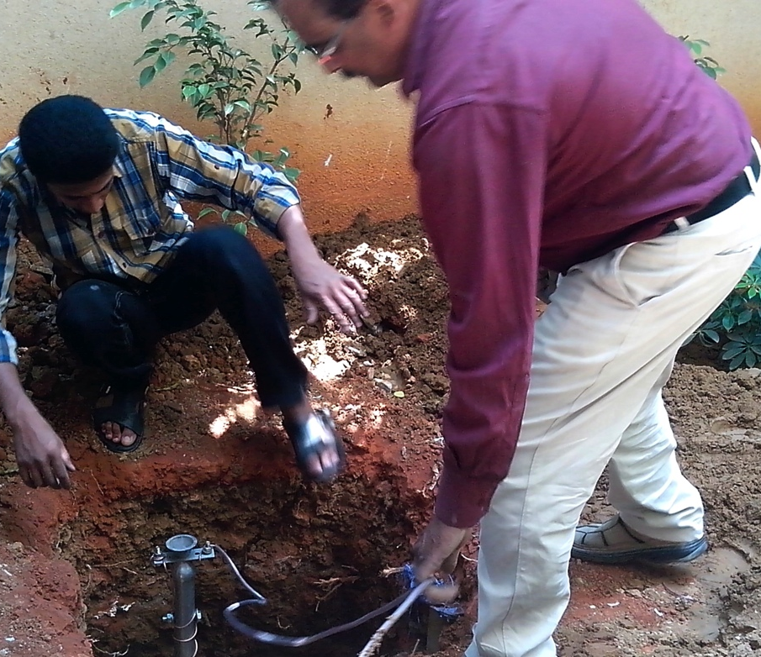
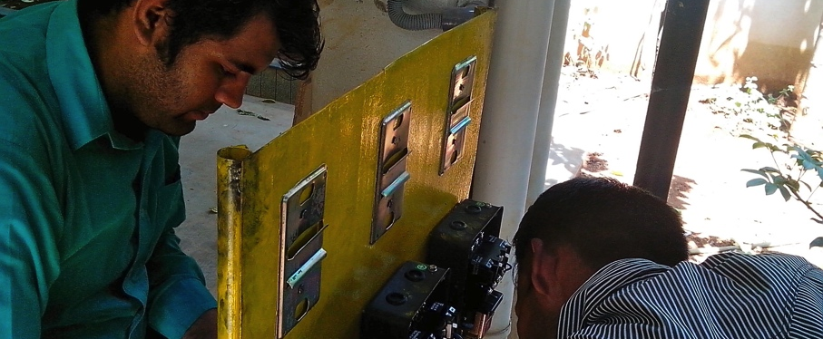
Earthin /Grounding
GreenBandhu and the management at Chitrakut environs set up the electrical connections, grounding, ensuring complete safety.

Slide 7
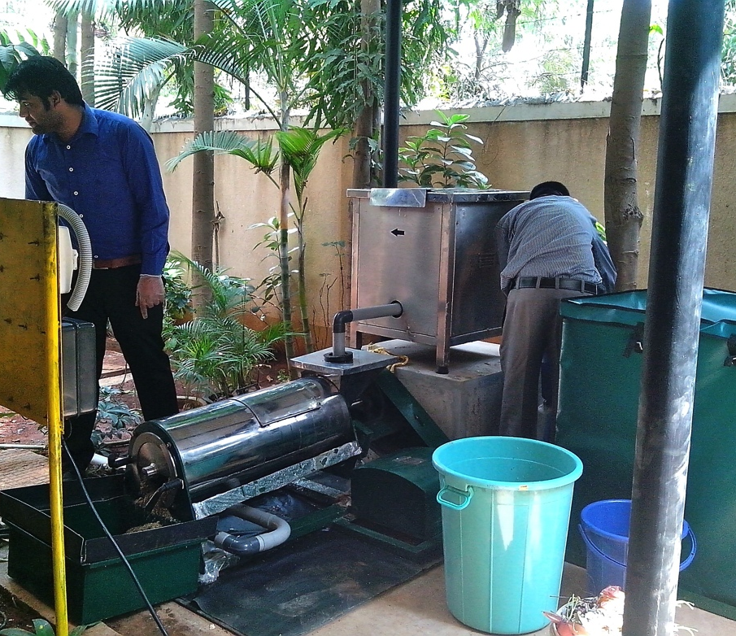
Organic Waste Processing Unit
After all arrangements to ensure maximum productivity of equipment, the machines were set to roll to process organic / wet waste collected within the community @Chitrakut Environs.

Slide 8
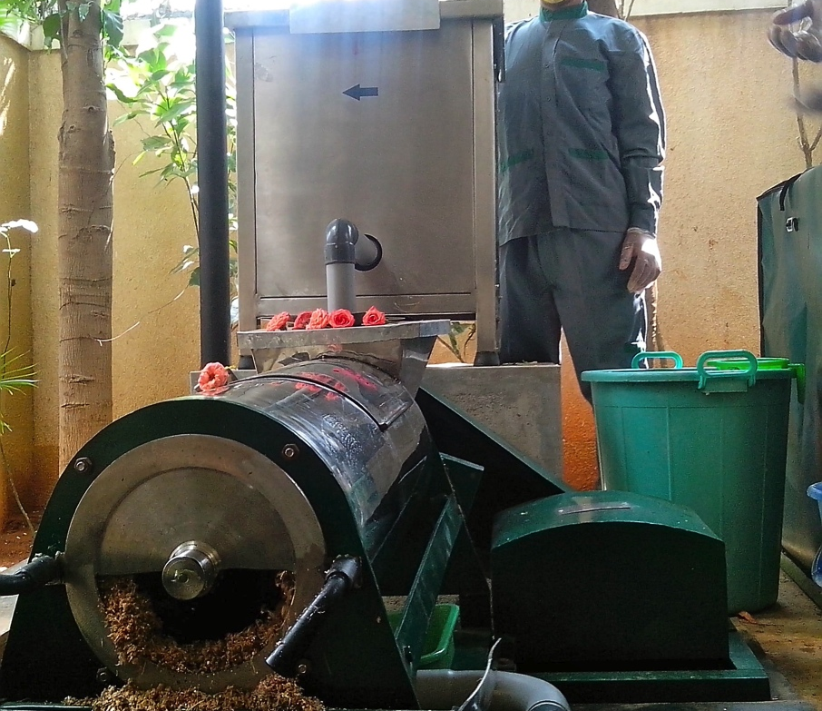
Organic Processing Unit
The organic / wet waste processing unit was commissioned on 1 March 2015. It started processing all organic/wet horticulture waste generated by and at the community of 132.

Slide 9
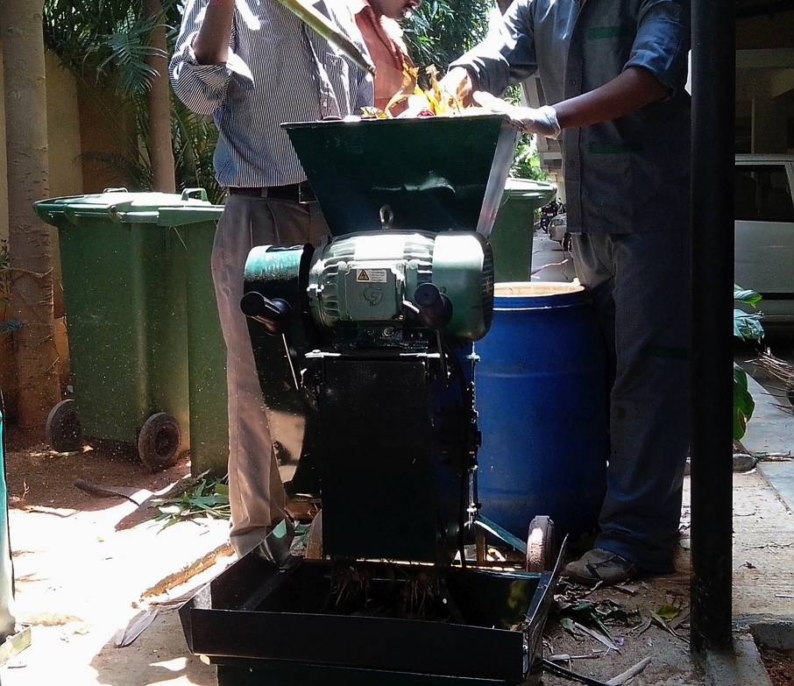
Horticulture Waste
Solution at Chitrakut Environs ensures all horticulture waste is processed daily and added to the processed organic waste to maintain C:N nutrient for good quality compost.
The shredder reduces the volume and size of horticulture waste by processing leaves, twigs. Branches. Breaking down helps in faster decomposing.

Slide 10
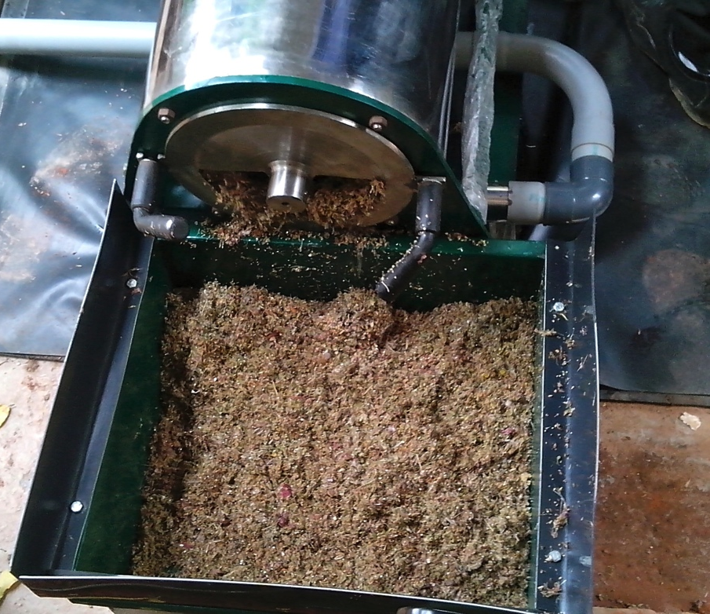
Output
Projected qty. of wet/organic including horticulture waste/waste generated at parties to be processed in a month
1920 Kg Food waste +50 Kg Horticulture waste + 30/50 Kg waste generated at events, parties.
An approx. 2/2.5 tonnes of organic waste will be processed into manure every month @Chitrakut Environs

Slide 11
Zero Dependancy
Zero dependence on civic authorities to responsibly dispose waste.
60/70 per cent of waste generated within a household is treated on a daily basis.
Ensures safe healthy living environment for the community.
Helps generate healthy organic manure with scope for additional income for the community.
Authorities cannot hold community responsible for not processing their own waste, as to not following guideline set for all bulk generating communities/institutions,organisations to be processing there wet waste internally.

